Slide 1
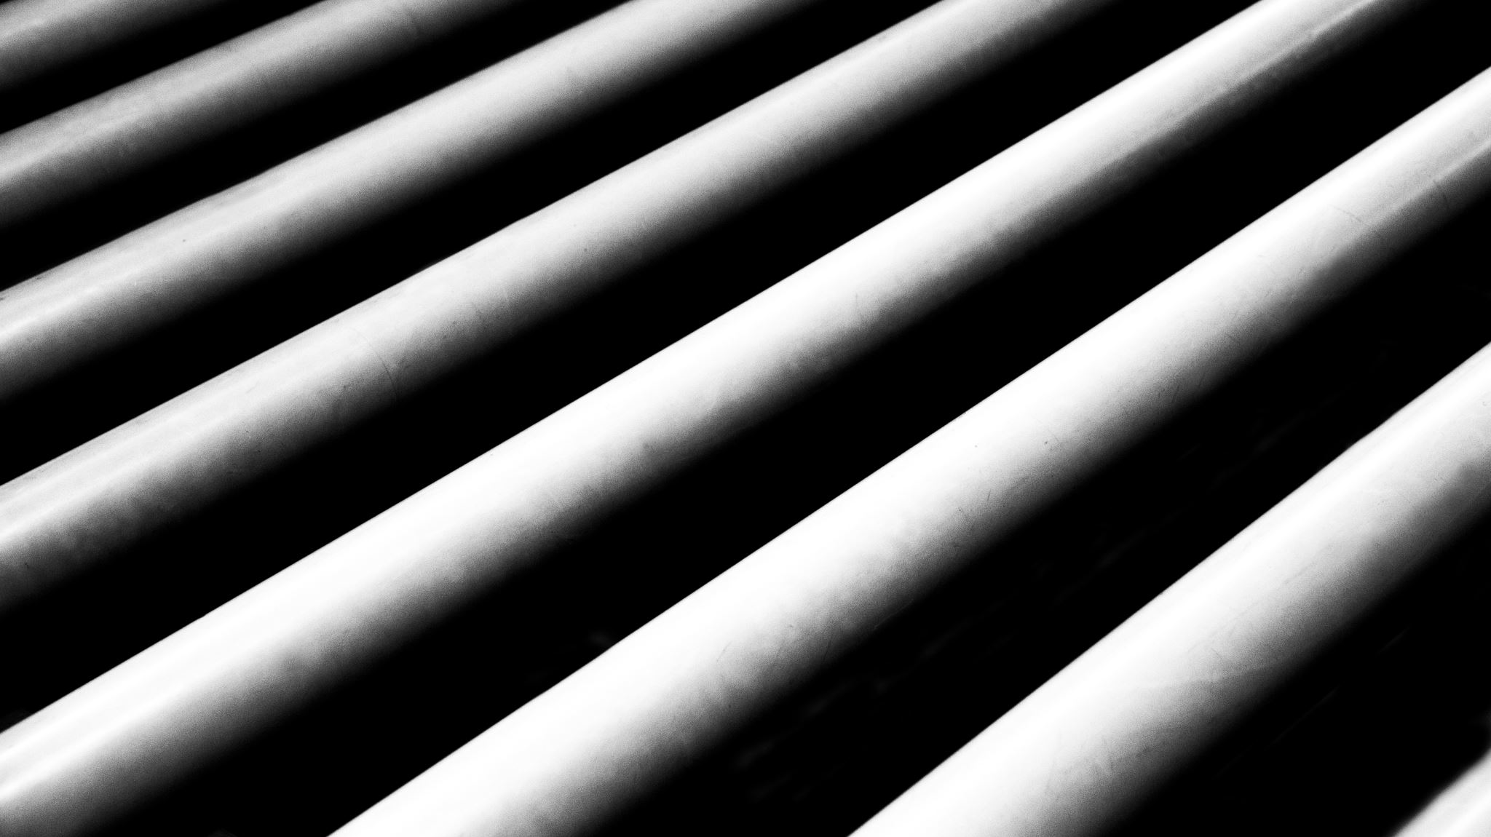
PIPE RACK

Slide 2
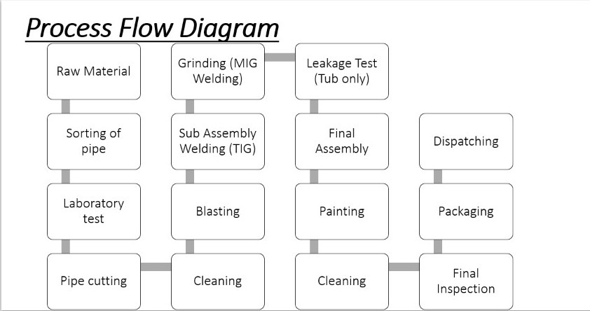

Slide 3
Process Flow Diagram
Raw Material ( From M/s Cooper India Company, Mumbai )
Sorting of pipe according to OD (outer diameter) in various section
Piece of pipe i.e. 200mm cut is send to laboratory for various test
Pipe Cutting
Removal Of Corrosive Part from raw material (pipes)
Sub Assembly Welding
Leakage testing is taken place to prevent any fault in job.
Cleaning process
Applying Thinner Oil to prevent corrosion
Checking Quality and overall dimension accurately with help of fixture.
Packing and Dispatching

Slide 4
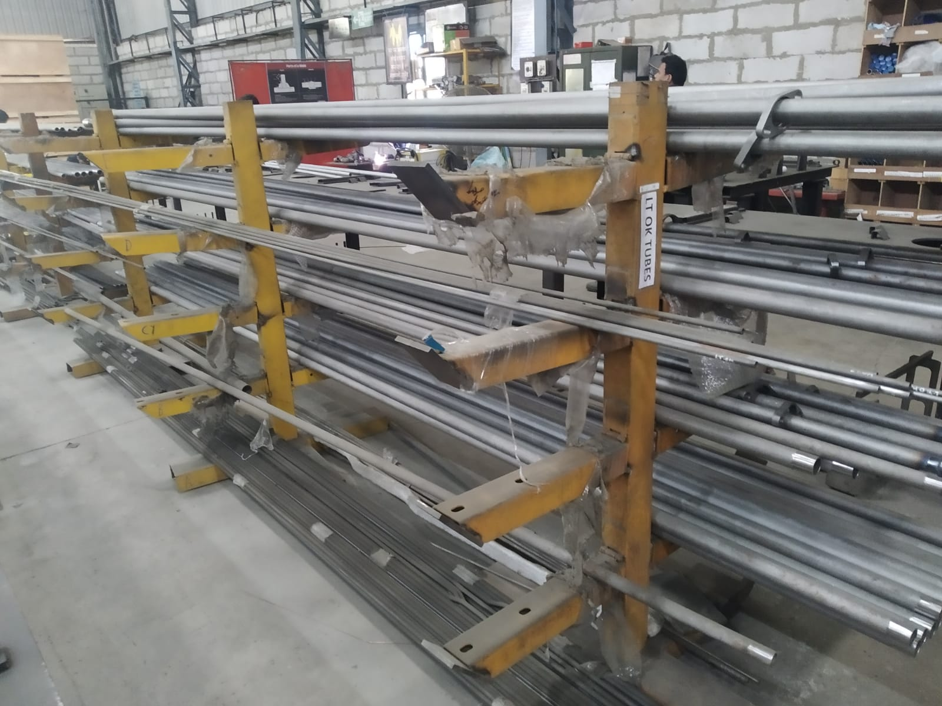
Pipe Rack
Parts Manufactured:-
Pipe Rack in factory are for IR4500 HP and IR6000 HP
Pipe rack is used for IR4500 HP and IR6000 HP.
Pipe Rack Filter Arm -(Only IR6000 HP).

Slide 5
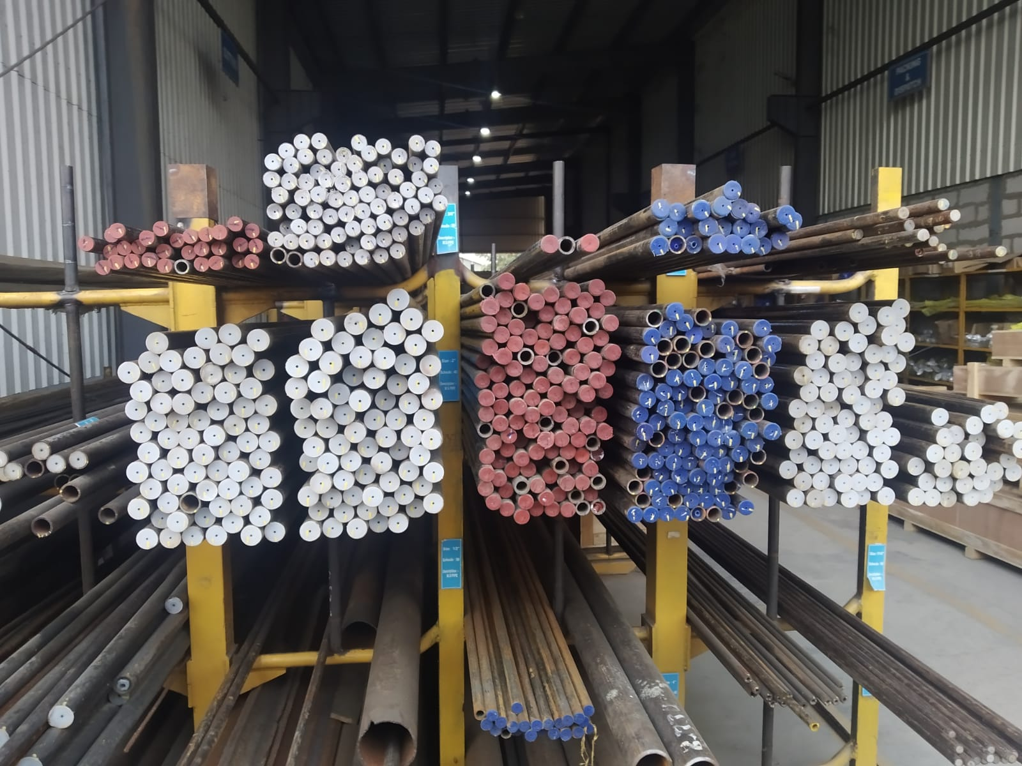
PROCEDURE FOR PIPE BENDING:-
First of all, raw material is brought from Copper India Pvt Ltd, Mumbai. Pipes are sorted according to schedule(unit for pipe) and outer diameter in rack
Pipe cutting is done according to size if pipe's OD(outer diameter) is small then it is cut manually (with help of cutting tool) and if OD is large then it is cut with help of machine.

Slide 6
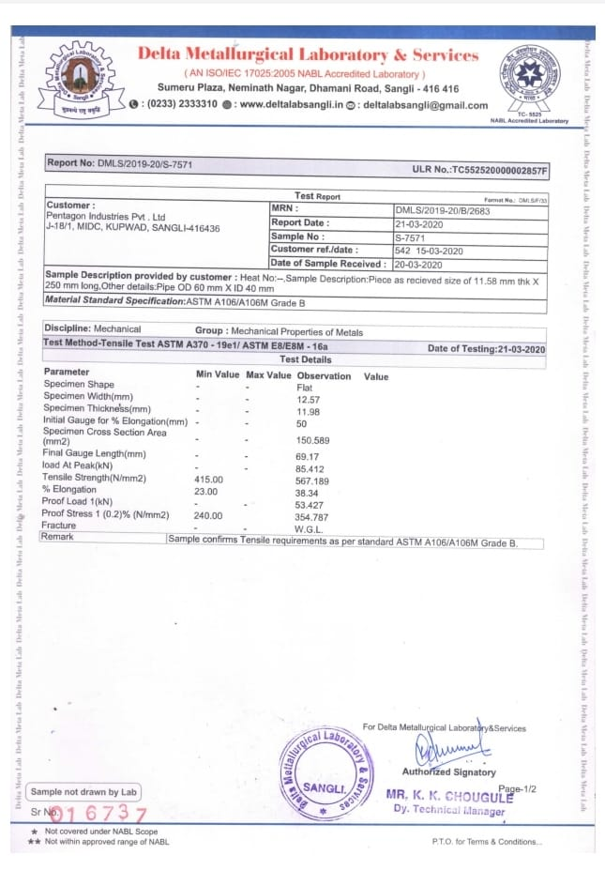
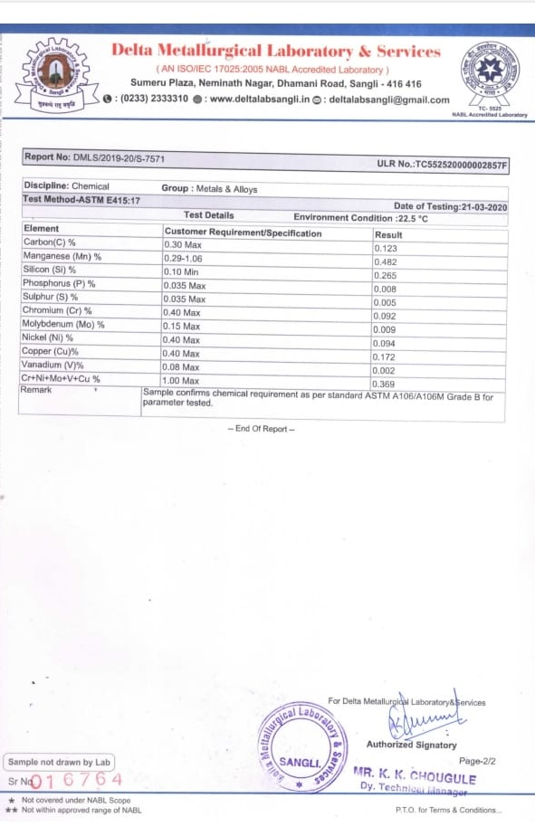
Pipe Laboratory Test
A cut of 200mm pipe of each OD is send to laboratory for various test so as to check raw material is of same grade which we had ordered.
Pipe is of material ASTM (American Society for Testing and Materials) 106 Grade B.
Two test are performed in UTM Machine
1.Mechanical
2.Chemical
Test are verified, later processed for further processing.

Slide 7
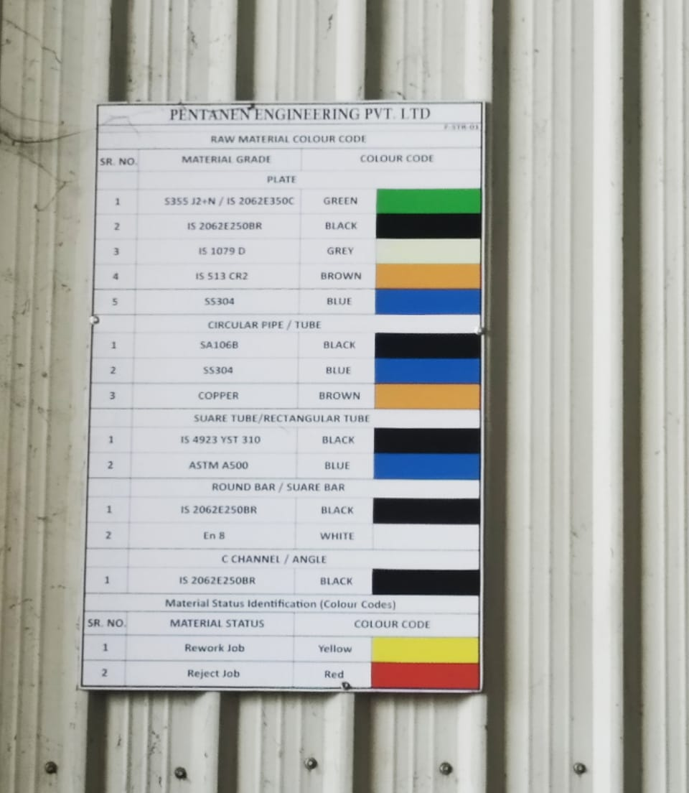
PIPE CLASSIFICATION
Pipes are classified into different sections accordingly and are verified ,finally yellow mark is used for rework job and red color is rejected material.

Slide 8
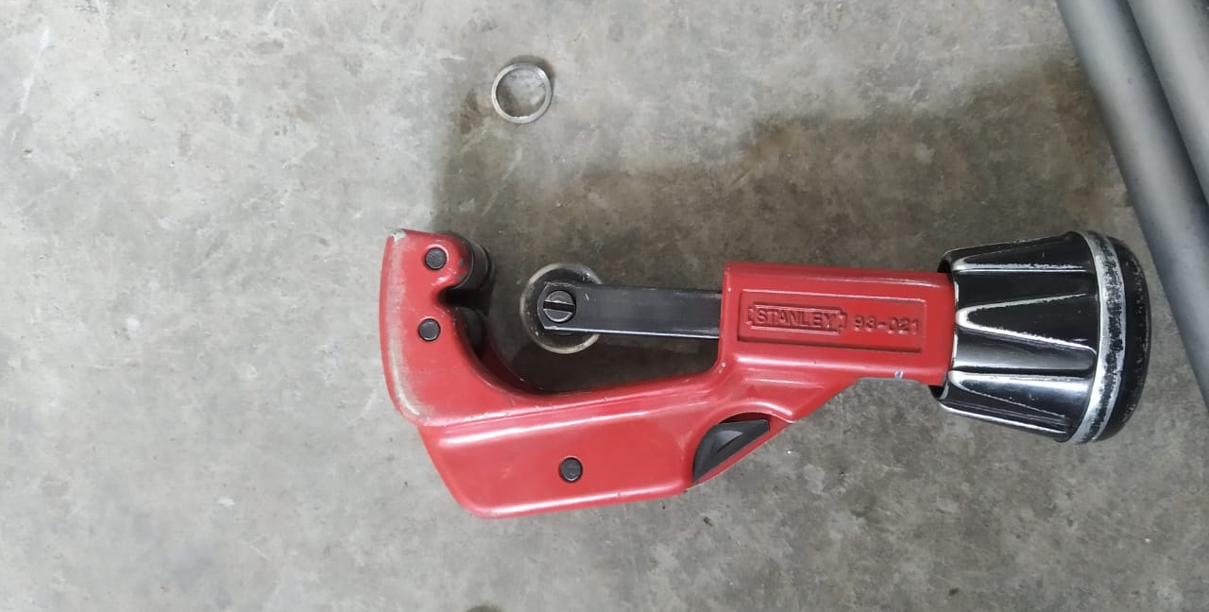
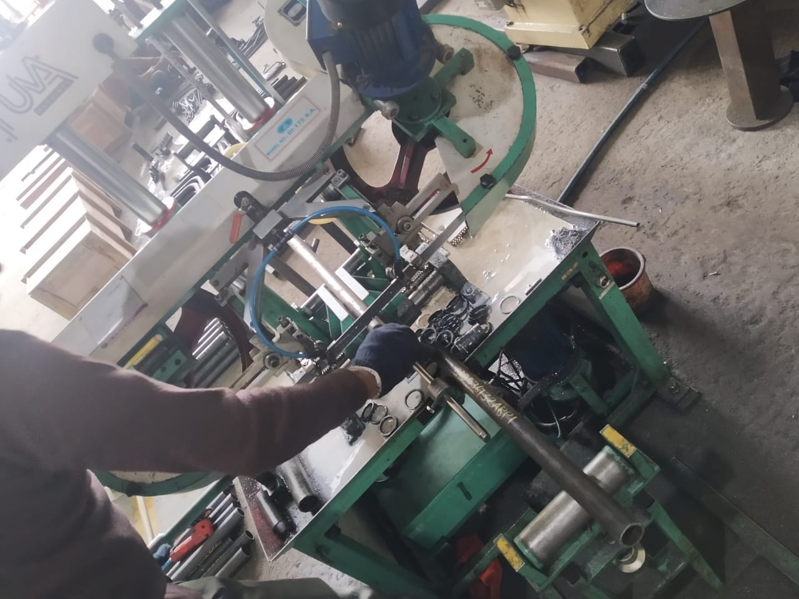
PIPE CUTTING PROCESS
Pipe cutting is done in two ways:-
1) Manual Pipe Cutting
2) Machine Pipe Cutting

Slide 9
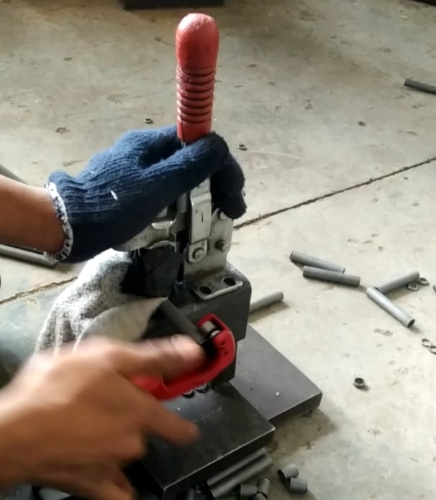
Manual Tube Cutting
In this process, the helper cuts the pipe of with the help of cutting tool, measure the distance on pipe and mark a line on pipe and rotate the tool by fixing it on surface, rotates the tool and creates a cut and unused part is cut from job. This tools and can cut the pipe whose OD lies between 3mm to 32mm. This tool is used to cut the small OD pipes

Slide 10
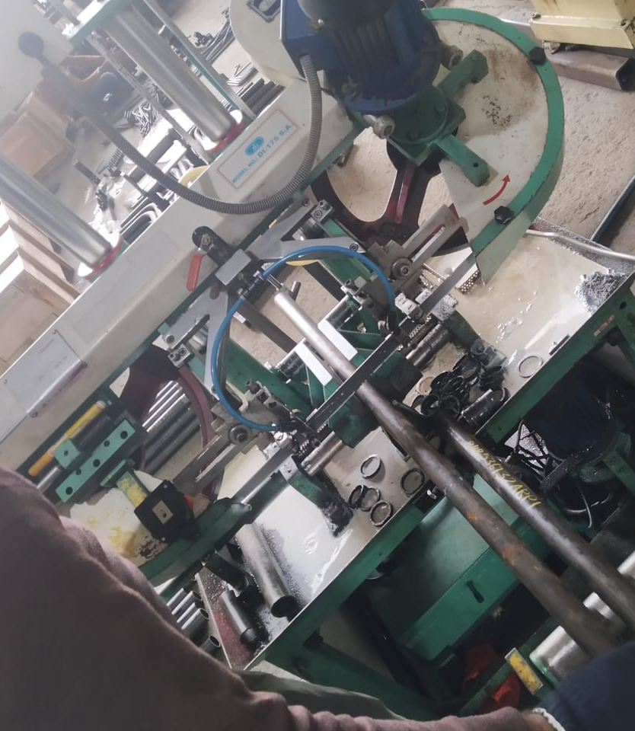
Bandsaw Machine
In this process, pipe having large outer diameter is used for cutting it into pieces before sending to removal of rust. Bandsaw Machine have a long blade placed horizontally in it and cutting oil is used to overcome friction while cutting. Now pipe is placed in middle of the machine and machine cuts it according to requirement helper has to hold it until it cuts. White color like cutting oil is their while the process of cutting takes place at the point of cut. Later pipe is cut into two pieces and processed ahead.

Slide 11
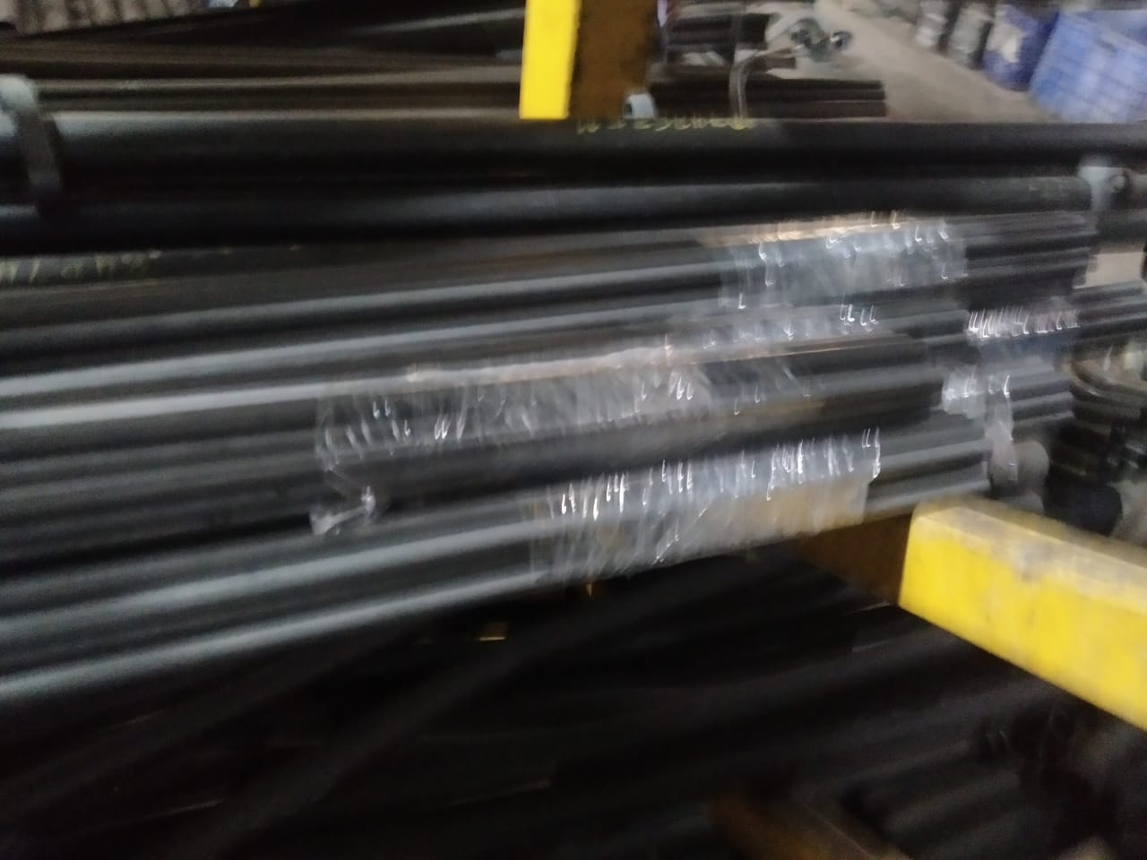
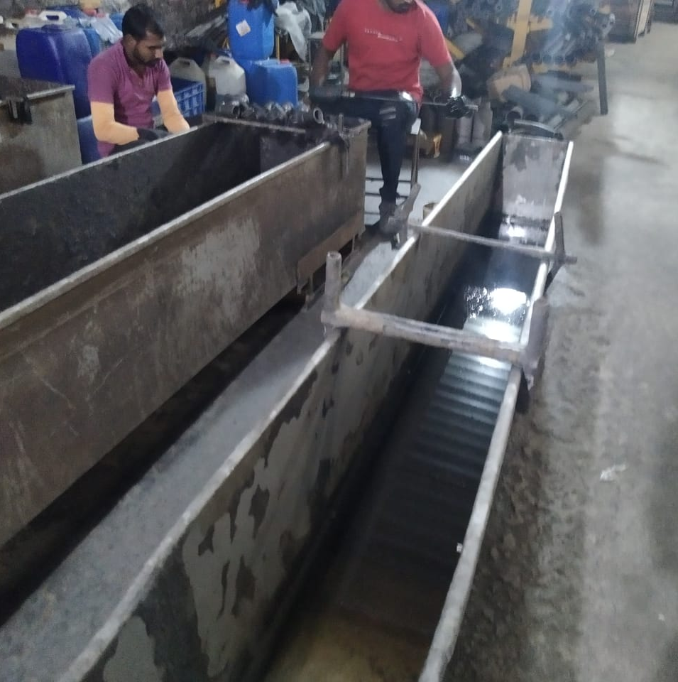
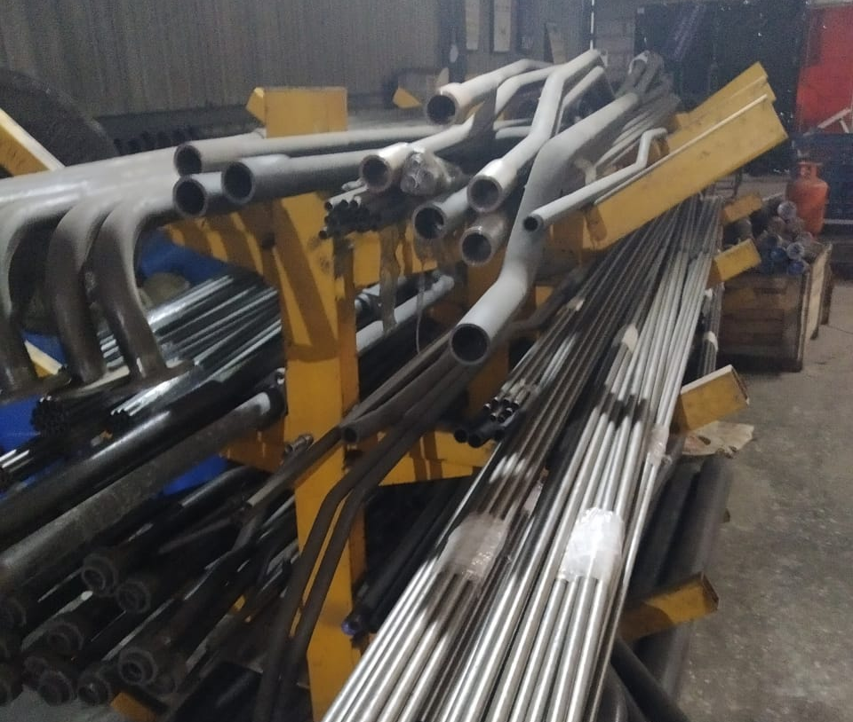
Removal Of Corrosive Part from Pipes.
Next step is to clean the pipe by applying solution to it so that there are no possibilities of corrosion further. Pipe is kept in solution for some time and later it is cleaned by cloth ,solution is applied from inside also with the help of drill like machine and later processed for bending to a desired shape. This process is first done for small OD because applying solution to pipe after bending is difficult. For OD > 32mm, job is made first and later processed for applying solution.

Slide 12
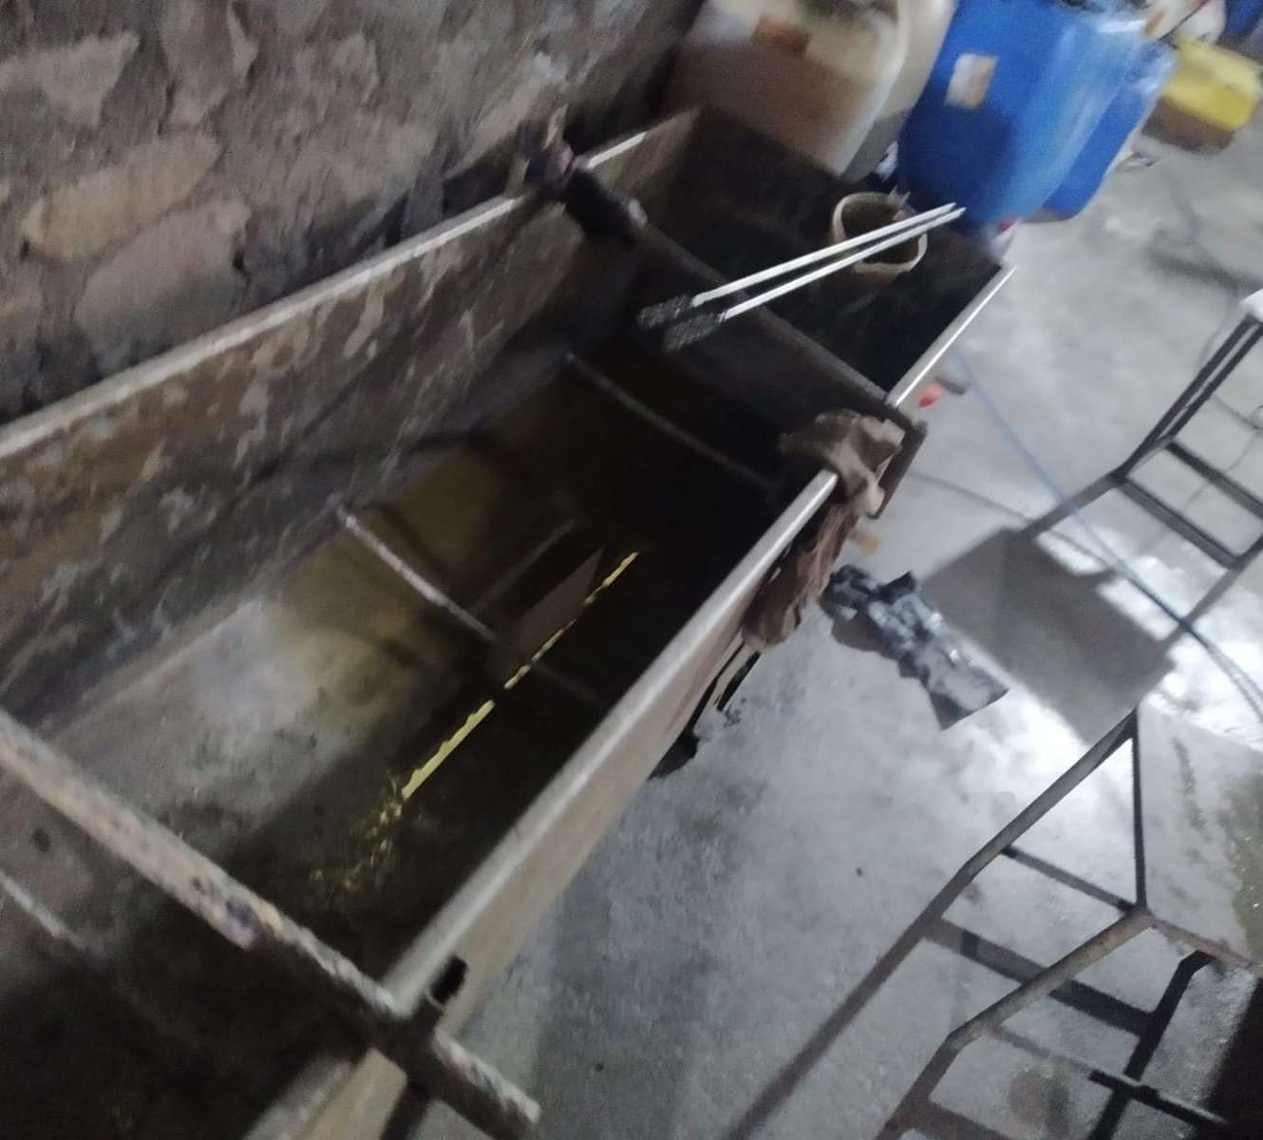
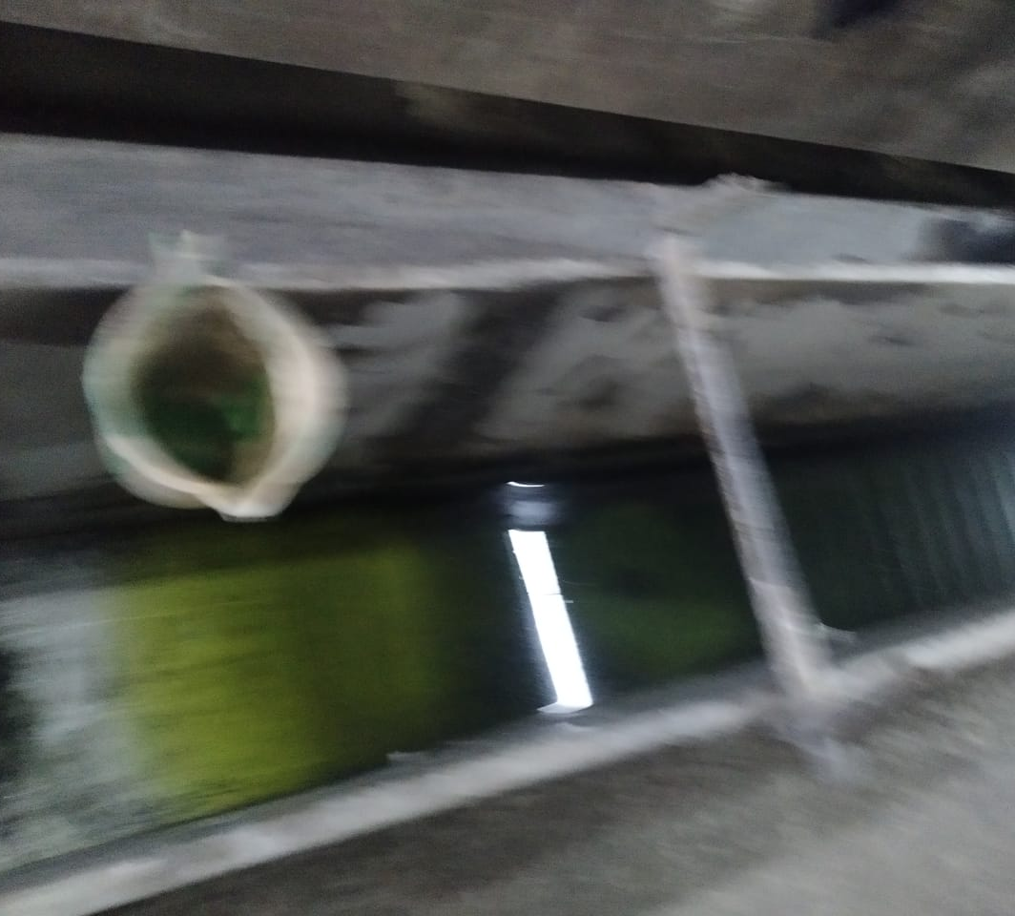
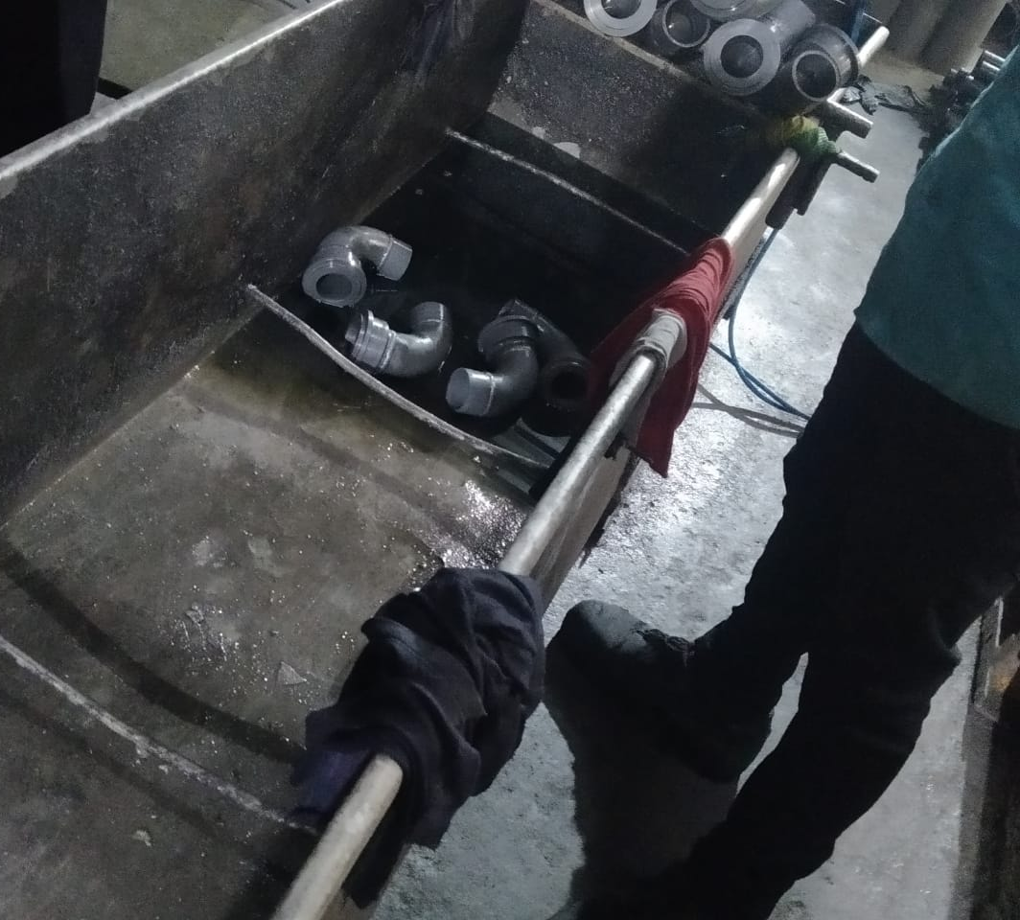
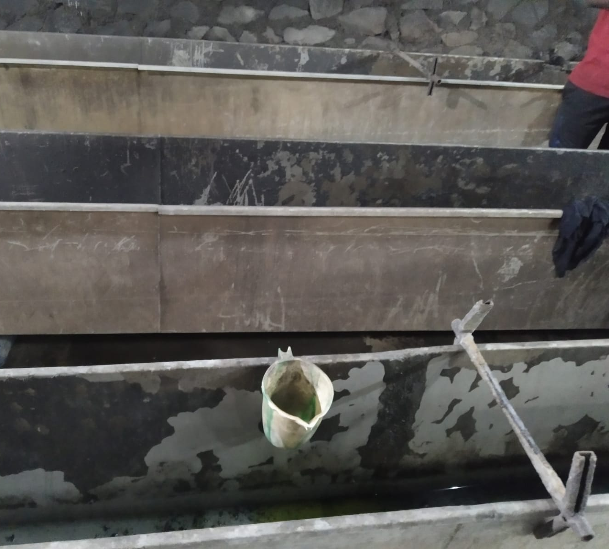
Process to remove corrosive part
1st step is to clean the job, job is merged in nanocoat solution for 30 mins to clean the job well.
While changing the solution section, job is cleaned with cotton cloth and air is given to it, later submerged in another solution.
Next step, it is kept in diesel so as to clean the inner part of job well it is also kept for almost 20 – 30 mins
Later finally it is cleaned with oil and again air is given to remove excess oil, finally job is cleaned and ready for next process.

Slide 13
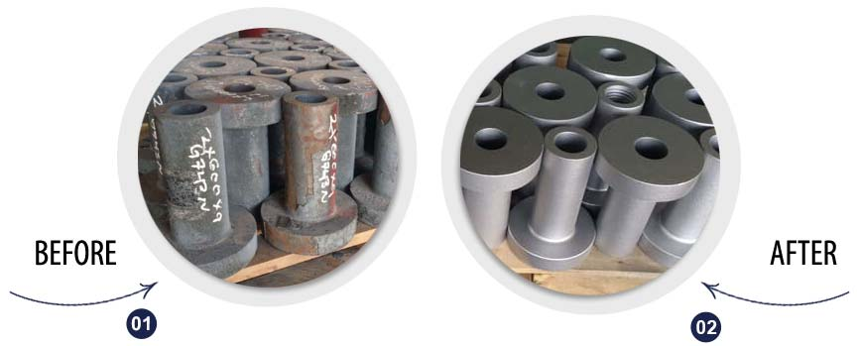
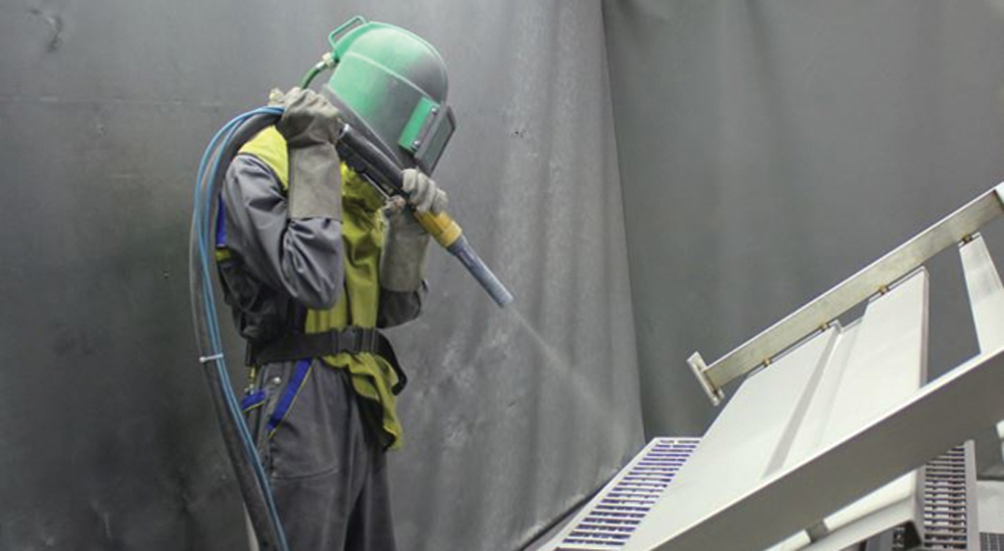
Blasting Process
Shot blasting is a resurfacing process used to remove debris and irregularities from concrete, metal, and other industrial surfaces. The shot blasting process utilizes a centrifugal blast wheel that shoots media, like steel shot, onto a surface at high velocity. Blasting is done as per requirement of customer. All pipes in Pipe rack, blasting is done.

Slide 14
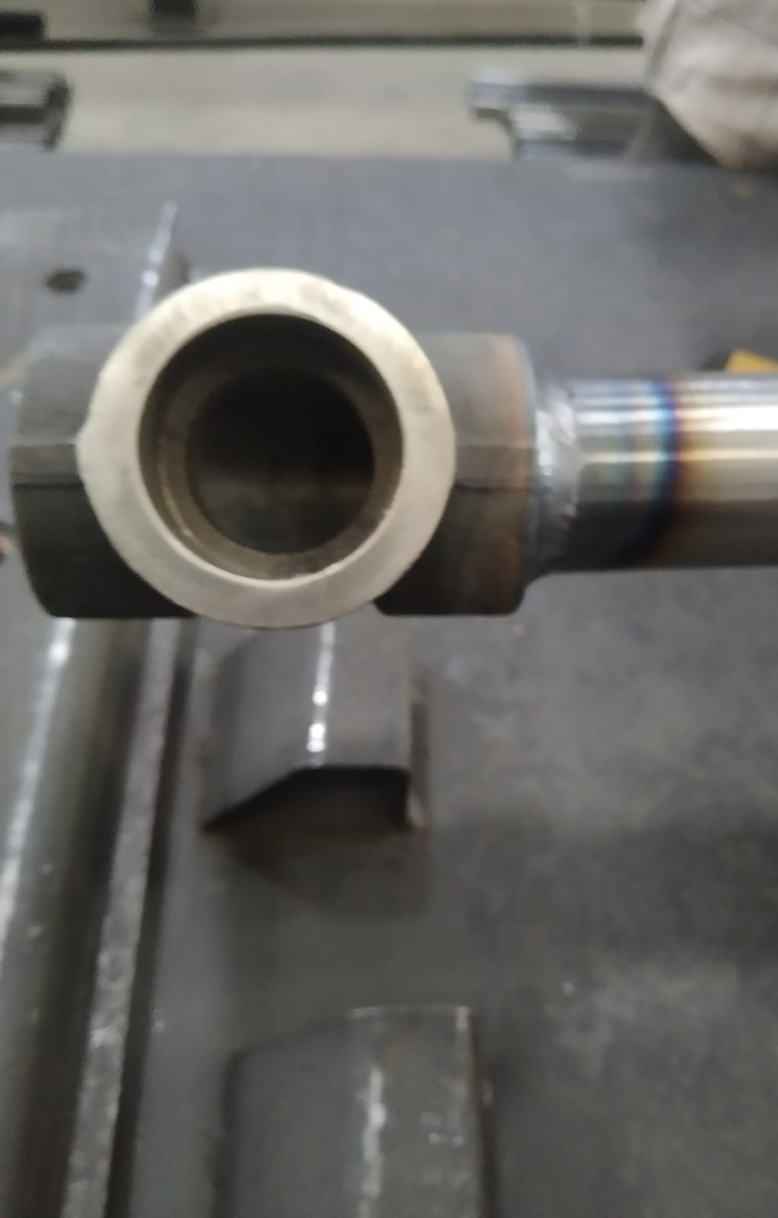
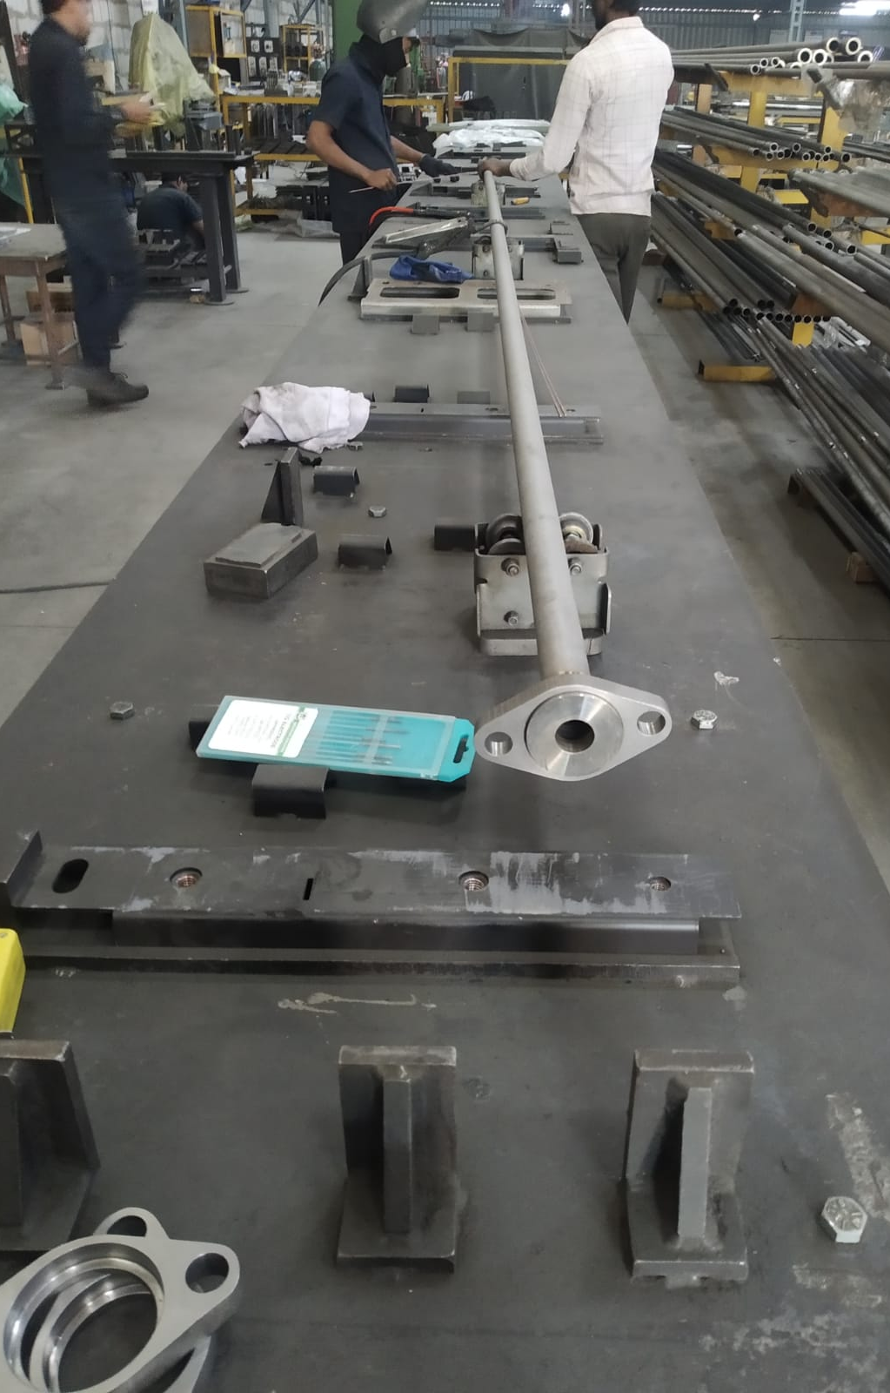
Pre-Assembly Process for Pipe rack
Pipe are joined by Union T-joint or coupler
Coupler is used to join to big length pipes, and union hex joint is used to joint 2 tubes.
All pipes are assembled on surface table and later joined by it with a horizontal bar placed at 1000mm below it, on this pipe rack is assembled with various child parts and flange nut, tee joint.
Mig Welding is done to join pipes at end.

Slide 15
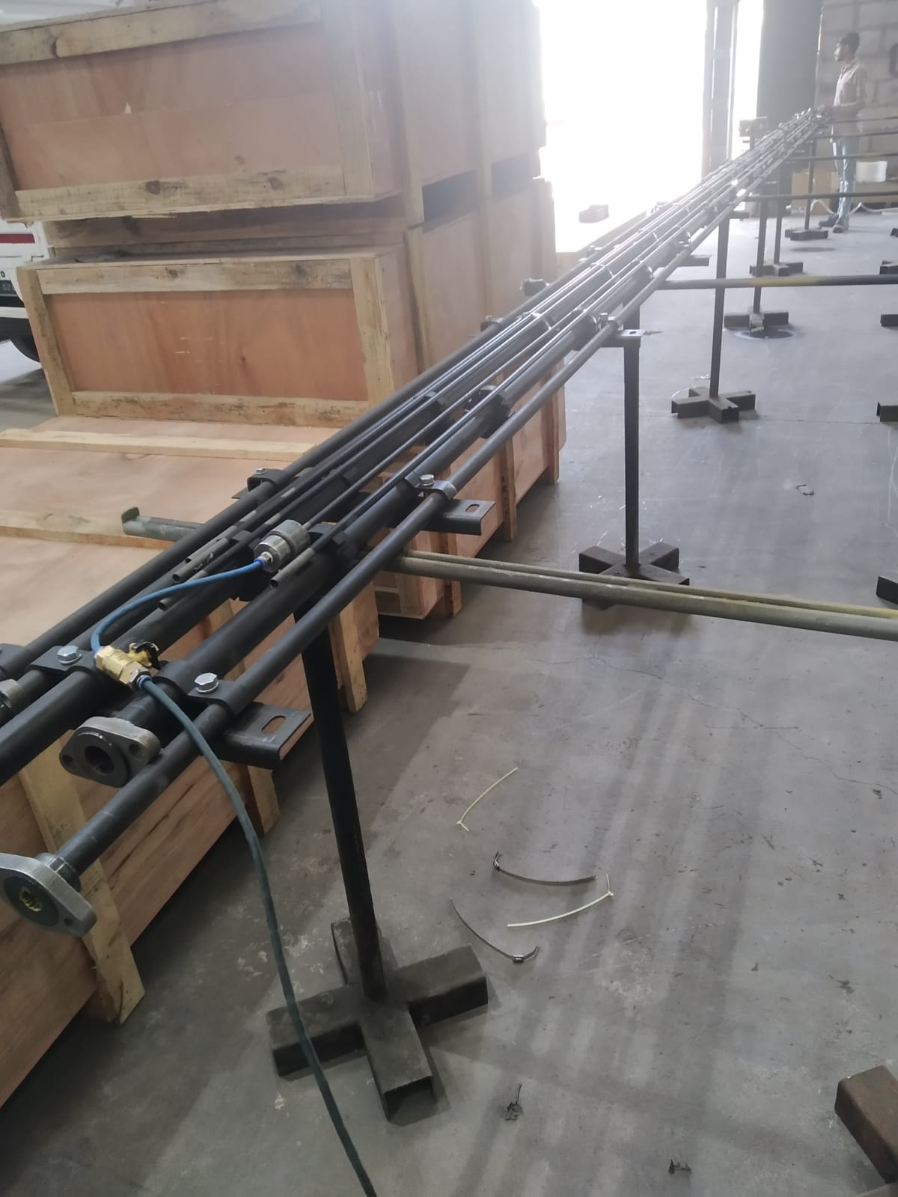
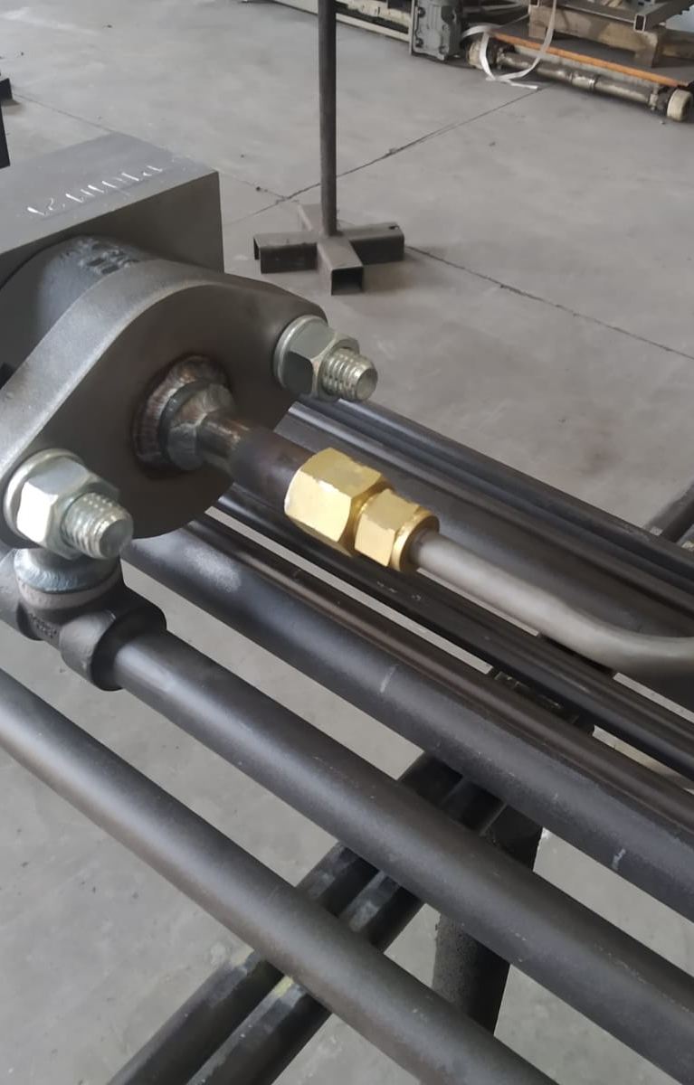
Assembly of Pipe Rack
Pipe rack is assembly of pipes with various components in it, pipe are connected by various union such as tee joint bracket etc according to drawing.
Mother parts, child parts and flaunge, nuts are assembled to pipe and processed for leakage testing again(only for tubes).
Inspection is done with reference to production drawing by quality engineer.

Slide 16
Painting and Dispatch
Assembly is completed, inspection is done, painting is done on it and kept for few minutes to dry it and later dispatched.

Slide 17
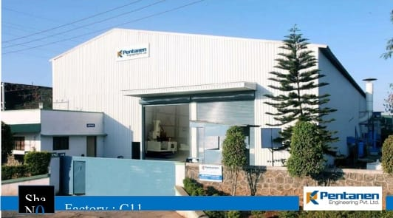
Thank you

Slide 18
